Slide 1

GOEL INSTITUTE OF TECHNOLOGY & MANAGEMENT, LUCKNOW
STUDENT INTRODUCTION
Atul Mishra
B.Tech – Computer Science Engineering
ROLL NUMBER
BRANCH
COURSE
2403600109007
Computer Science Engineering
B.Tech
Goel Institute of Technology & Management
Data Analytics Internship · Power BI Project

Slide 2
ABOUT ME
The Person Behind the Project
PY
Python
AM
Scripting & data analysis
TS
Time Series Analysis
Trend & forecasting techniques
Atul Mishra
N8
Workflow Automation (n8n)
Aspiring Data Analyst
Automating data pipelines
B.Tech – Computer Science Engineering
SQL
SQL
Querying & structuring data
Goel Institute of
Technology & Management
XL
Excel
Roll No. 2403600109007
Data cleaning & reporting
02

Slide 3
PROJECT OVERVIEW
Why This Dashboard?
1
Track overall sales, profit and order volume at a glance
OBJECTIVE
Design and build an interactive Power BI dashboard that turns raw retail sales records into clear, actionable insights — styled around Blinkit's quick-commerce identity to make the analytics feel product-ready.
2
Spot return patterns by category and payment mode
3
Compare performance across regions and product lines
SCOPE OF WORK
Data cleaning → modeling → KPI design → visual storytelling → interactive filtering, delivered as a single-page executive dashboard.
4
Let viewers filter by quarter and metric interactively
03

Slide 4


Project Overview & Objectives
Background & Problem Statement
Key Analytical Objectives
Quick-commerce platforms handle massive transaction volumes daily. Analyzing sales performance across different outlet locations, payment modes, and item categories is vital for optimizing logistics and stock distribution.
Build an interactive Power BI dashboard featuring dynamic KPI cards, location performance curves, payment mode breakdowns, and item-level category filters to empower data-driven decisions.

Slide 5
DATA FOUNDATION
Dataset & Preparation
A retail sales dataset (order, product, region and shipping details) was cleaned and modeled, then visualized on a Blinkit-branded report canvas.
Sales
Profit
Quantity
Returns
Category
Sub-Category
Product Name
Region
Payment Mode
Ship Date
Order / Row ID
Total No. of Sales
Prep pipeline: Excel (cleaning) → SQL (structuring & queries) → Power BI (modeling & visuals)
04

Slide 6
Internship Project Timeline
Week 4
Week 2
Insights extraction, report validation, and presentation compilation.
Schema modeling and DAX measures for KPI metrics.
Week 1
Week 3
Dataset acquisition, data cleaning, and Power Query transformation.
Dashboard UI/UX design, visual charts, and interactive slicers.

Slide 7
DASHBOARD DESIGN
The KPI Layer
Four headline cards plus a gauge give viewers the top-line picture in the first three seconds.
Total Sales
Total Profit
Total Quantity
Total Orders
Sum of order value
Net margin generated
Units sold
Distinct Row ID count
◎
Gauge — Total No. of Sales
Shows overall sales progress against target at a glance, sitting beside the KPI cards for instant context.
05

Slide 8
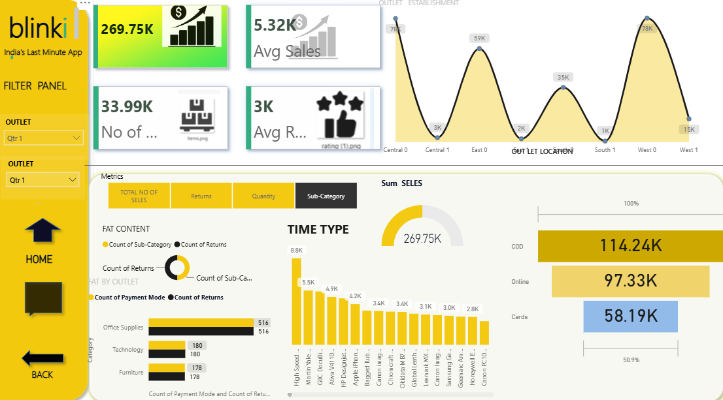

Slide 9
Outlet Location Performance
Outlet Location | Sales Volume ($) | Revenue Share (%) | Dominant Payment Method
West 0 | 78.00K | 28.9% | Cash on Delivery / Online
Central 0 | 78.00K | 28.9% | Online Payment
East 0 | 59.00K | 21.9% | Cash on Delivery
West 1 | 15.00K | 5.6% | Online Payment / Cards
Central 1 | 3.00K | 1.1% | Cash on Delivery

Slide 10
VISUAL STORYTELLING
Key Visuals & What They Reveal
◔
Donut Chart
▤
Clustered Bar
●
Combo Chart
Sub-Category mix vs. Returns — which product lines get sent back most.
Returns by Category & Payment Mode — where refund friction is highest.
Sales trend across Product Names, line + column together.
─
Line Chart
▲
Funnel Chart
Sales & Returns by Region over time.
Sales broken down by Payment Mode, from highest to lowest.
06

Slide 11
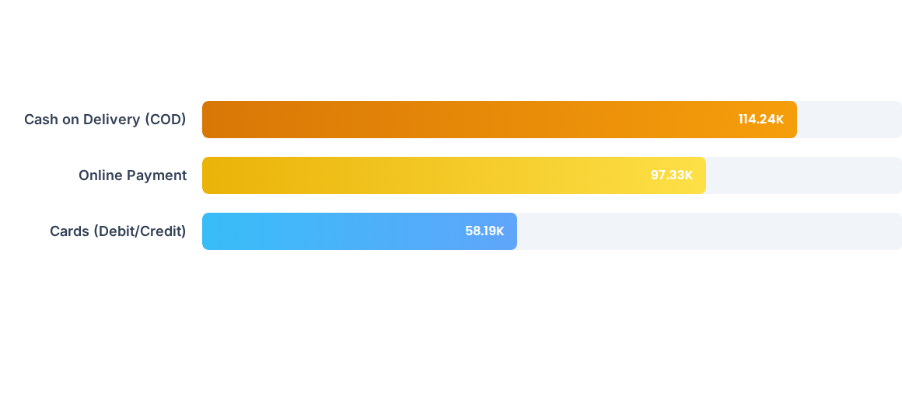
Sales by Payment Mode
Cash on Delivery (COD) accounts for the largest share at $114.24K, while digital payment methods (Online + Cards) combined represent over 57.6% ($155.52K) of total revenue.

Slide 12
USER EXPERIENCE
Built to Be Explored, Not Just Viewed
1
Quarter Slicer
Filters the whole page by Ship-Date quarter using the built-in date hierarchy.
2
Metrics Slicer
Lets viewers swap which measure the visuals respond to.
3
Filter Panel
A dedicated panel groups all slicers so filtering feels intentional, not scattered.
4
Home / Back Navigation
Simple nav buttons give the single page an app-like, multi-screen feel.
07

Slide 13

Total Sales Revenue Metric
Core Financial Performance
The dashboard evaluates 33.99K total item units sold across all outlet types, achieving an average transaction value of 5.32K with strong customer ratings across major regional outlets.
Total Revenue Generated ($)

Slide 14
TECH STACK
Tools Applied Across the Project
PO
EX
SQ
Power BI
Excel
SQL
Data modeling, DAX measures, and the full interactive report canvas.
Initial data cleaning, validation and quick sanity checks.
Structuring and querying the underlying sales records.
PY
N8
Python
n8n
Time-series exploration to spot trends before visualizing them.
Automating repetitive parts of the data workflow.
08

Slide 15






Key Dashboard Insights
Regional Peaks
Category Demand
Payment Preferences
West 0 and Central 0 outlets recorded peak sales performance reaching 78K each, outperforming South and East zones.
Office Supplies led category item counts (516 units), followed by Technology (180 units) and Furniture (178 units).
High-value orders favor Online & Card payments, while quick daily consumable purchases show higher reliance on COD.

Slide 16
REFLECTION
Key Learnings from This Project
✓
Translating raw sales records into a clear KPI story for a non-technical viewer.
✓
Choosing the right chart per question — donut for mix, funnel for drop-off, combo for trend.
✓
Designing slicers and navigation so the dashboard feels like a small app.
✓
Connecting Excel, SQL and Power BI into one clean end-to-end workflow.
Next step: extend the model with cohort-level and time-series forecasting.
09

Slide 17
Thank You
Questions & Discussion Welcome
Atul Mishra
B.Tech – Computer Science Engineering · Roll No. 2403600109007
Goel Institute of Technology & Management, Lucknow
Aspiring Data Analyst | Python | Time Series Analysis | Workflow Automation (n8n) | SQL | Excel

